Slide 1
Cortical States
By: Nicole Phillips

Slide 2
Learning Objectives
Describe circadian rhythm and identify biological structures that help maintain circadian rhythm.
Recognize the biological and behavioral markers of different stages of sleep.
Describe how progression through sleep stages changes across a night of sleep as well as across the lifespan.
Identify the purposes of sleep and what happens to cognition and behavior when we do not get enough sleep.
Describe the default-mode network and its importance in cognitive functioning

Slide 3
Circadian Rhythm

Slide 4

Circadian rhythm
A pattern of behavioral, physiological, or biochemical fluctuation that has a 24 hour period.
  Diurnal: active during light
  Nocturnal: active during dark

Slide 5
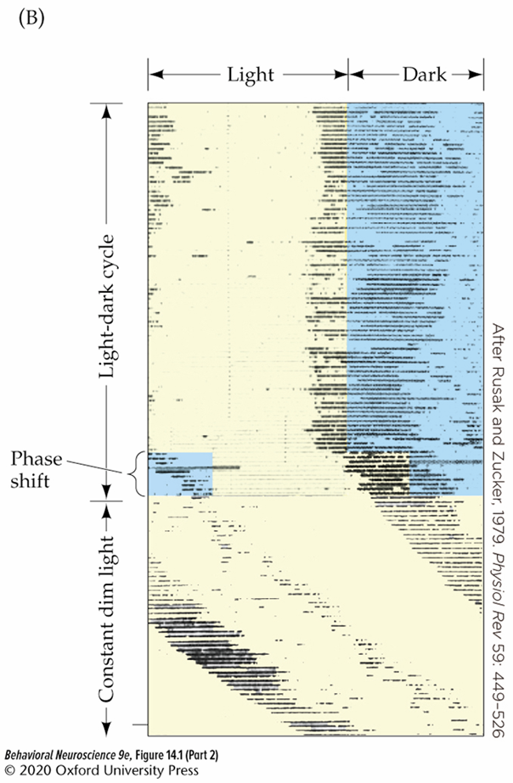

Light is an important cue for circadian rhythm
Delaying the onset of light/dark will cause a phase shift.
In constant darkness, the onset of activity each day will start to shift slightly.
This Photo by Unknown Author is licensed under CC BY-SA-NC

Slide 6
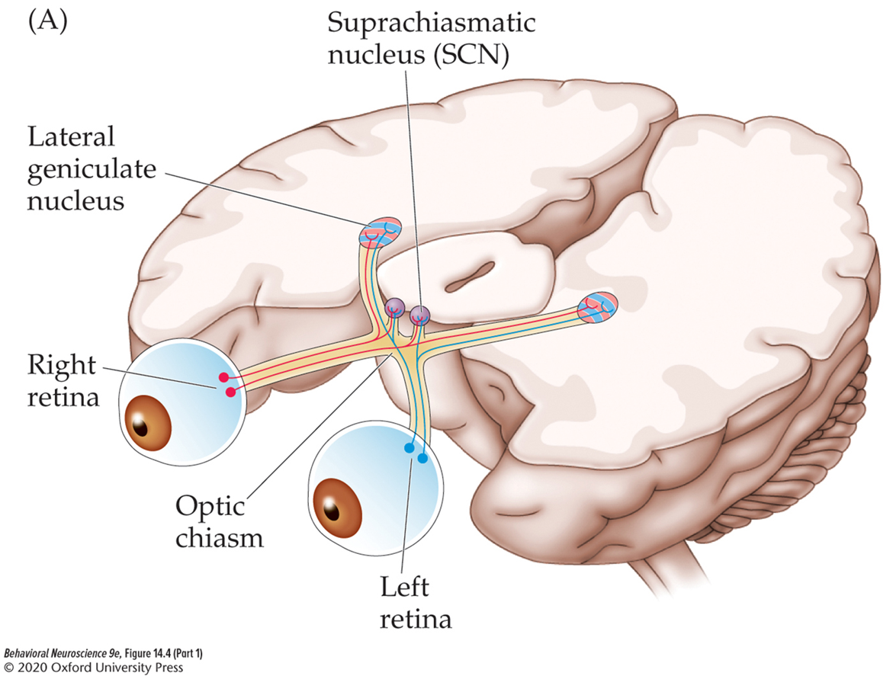
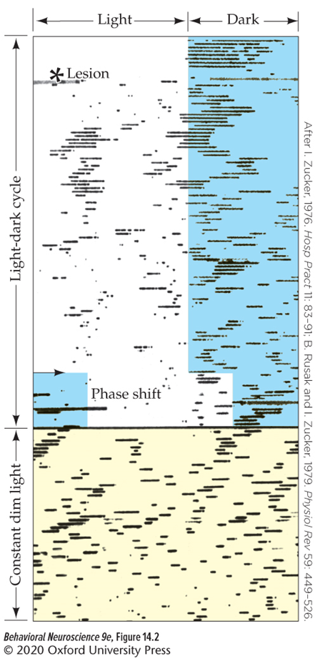
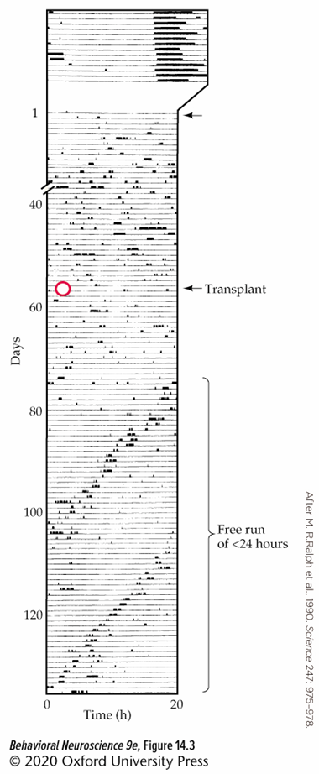
The Suprachiasmatic nucleus (SCN) of the hypothalamus controls circadian rhythm
Lesions of the SCN throw off circadian rhythm.
When the SCN is transplanted into another animal, the host animal will follow the circadian rhythm of the donor animal.
Some axons of the optic tract synapse directly with the SCN!

Slide 7
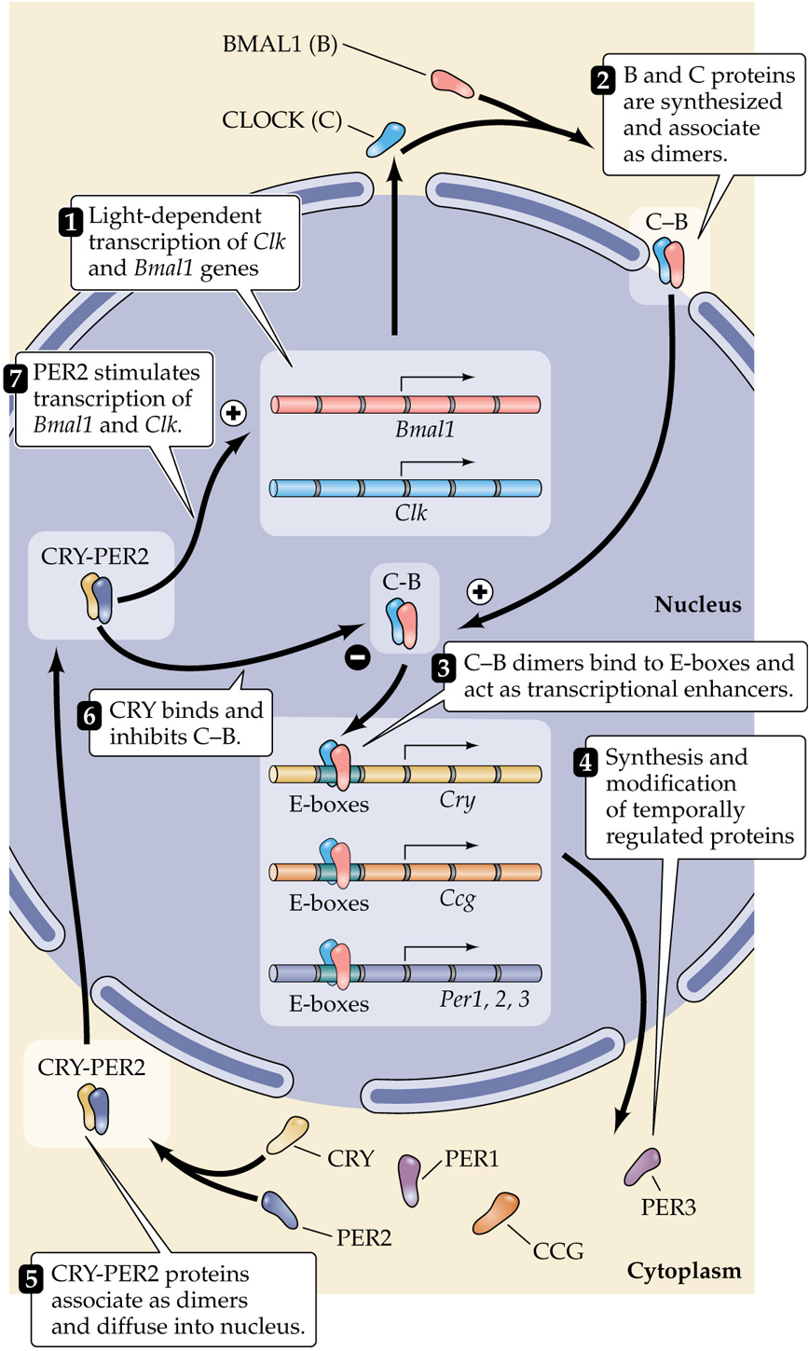
Cellular cycles in the Mammalian SCN

Slide 8
Sleep

Slide 9
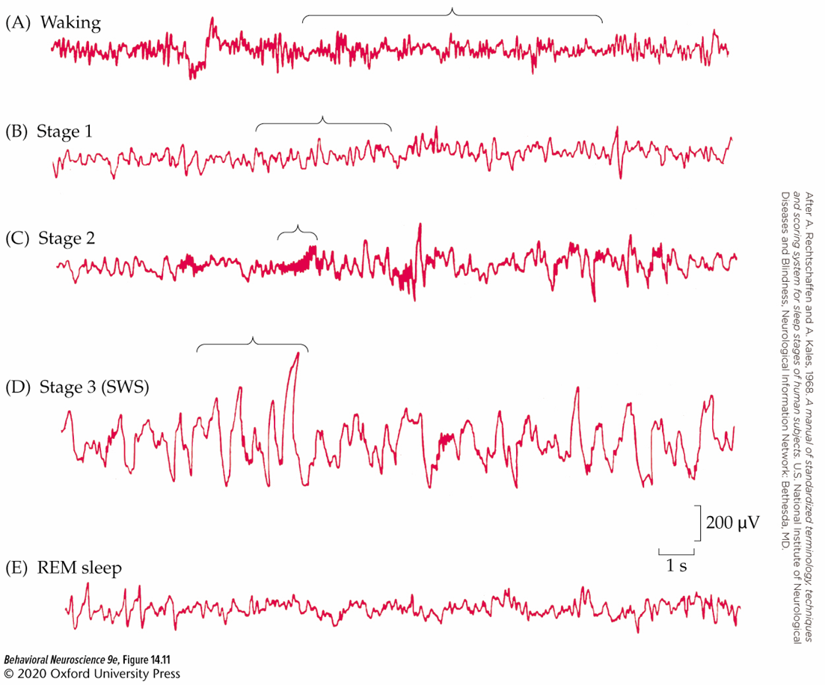
Sleep is separated into 4 distinct stages Based on brain activity
Non-REM
  N1= Theta waves (drowsy)
  N2= Sleep spindles and K-complexes, (light sleep)
  N3= Delta waves (Slow wave sleep)
Rapid Eye Movement (REM)
The progression through these stages (sleep cycle) typically takes about 90 minutes.

Slide 10
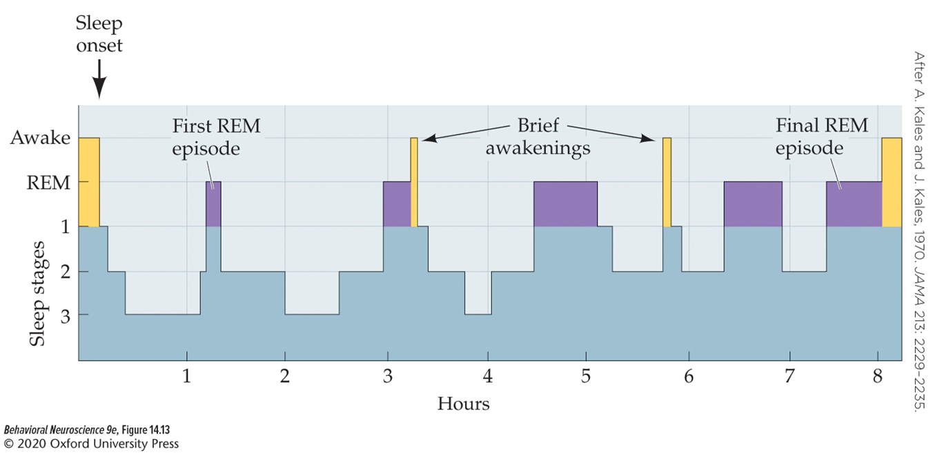
Time spent in Sleep Stages Changes throughout a night of sleep

Slide 11
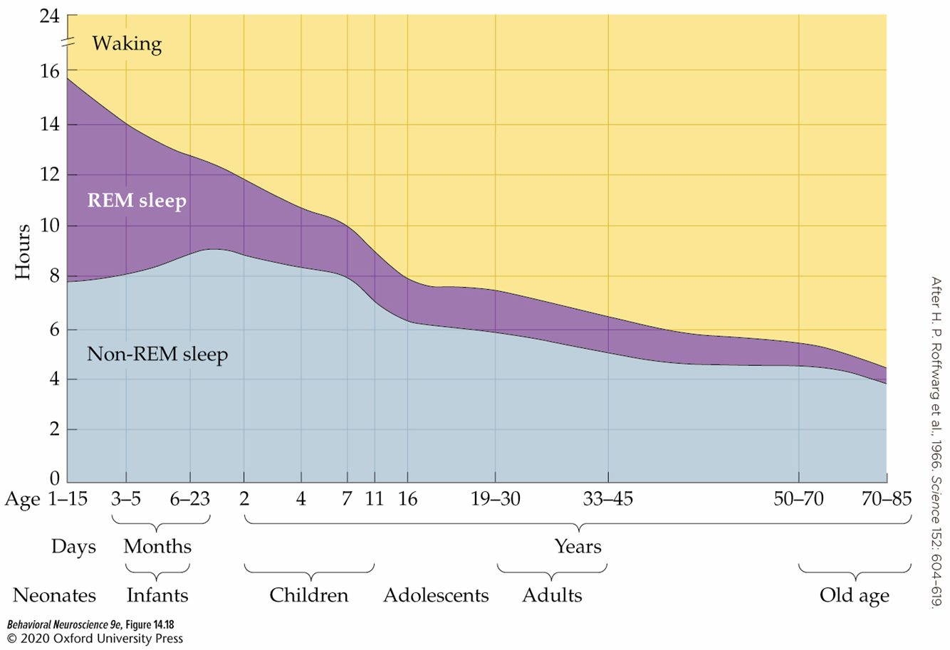
Time spent in sleep stages changes throughout the life-span

Slide 12
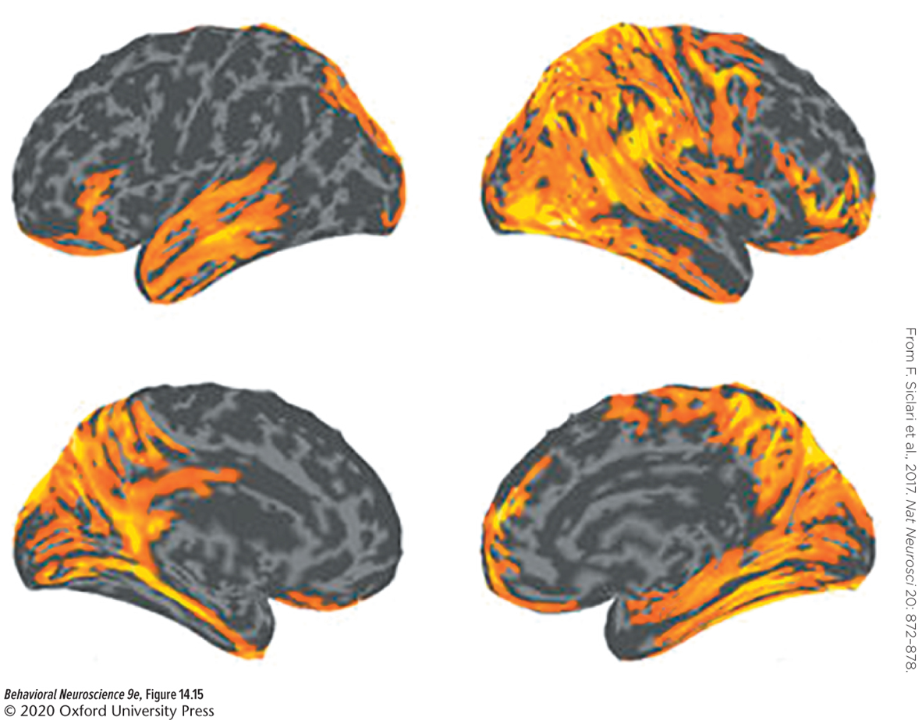
A Neural marker of dreaming?
Vivid dreams can be predicted if there is a lot of high-frequency EEG activity in posterior cortex regions.
Siclari et al, 2017

Slide 13
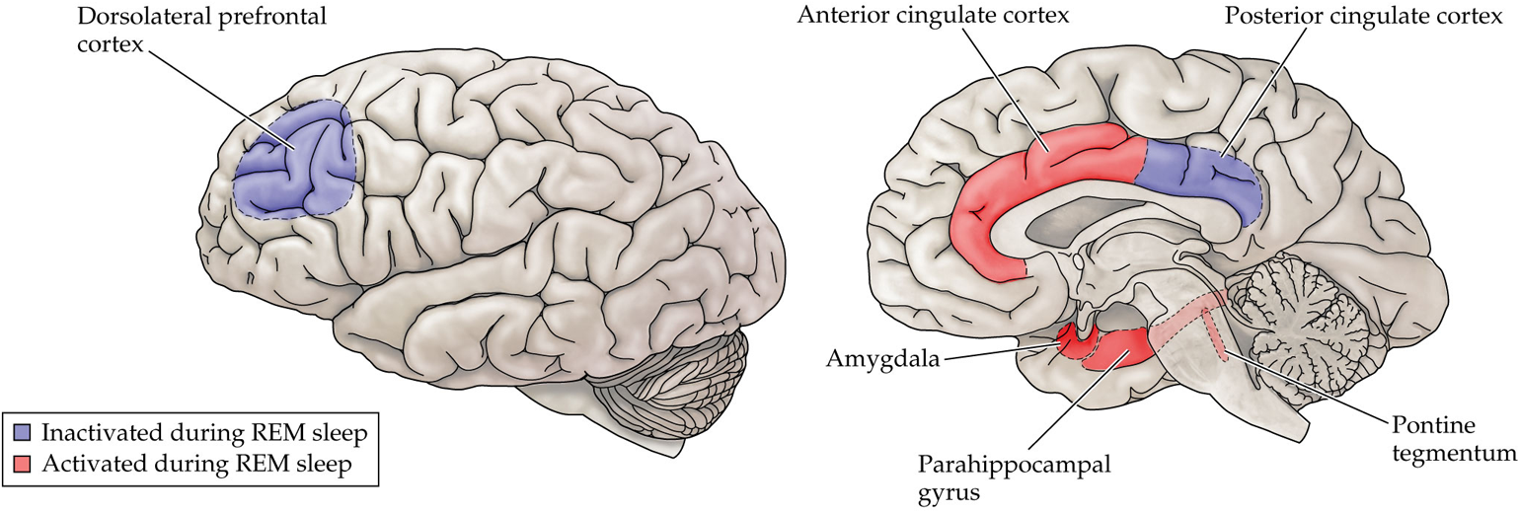
Brain activity Changes during REM/Dreaming
May help explain unique qualities of dreams during REM
Notes:
Decreased dlpfc and pcc
The increase in activity of brain regions critical for emotional processing, coupled with a marked decrease in the influence of the prefrontal cortex, presumably explains some characteristics of dreams (e.g., their heightened emotionality in REM sleep and their often inappropriate social content).

